Slide 1
Mental Health Analysis using Chatbot
-By
Anjali Gaikwad
Rakshanda Thorat
Sarah Joshi
Shivani Ladkat

Slide 2
Contents
Problem Statement
Objective
Key Features

Slide 3
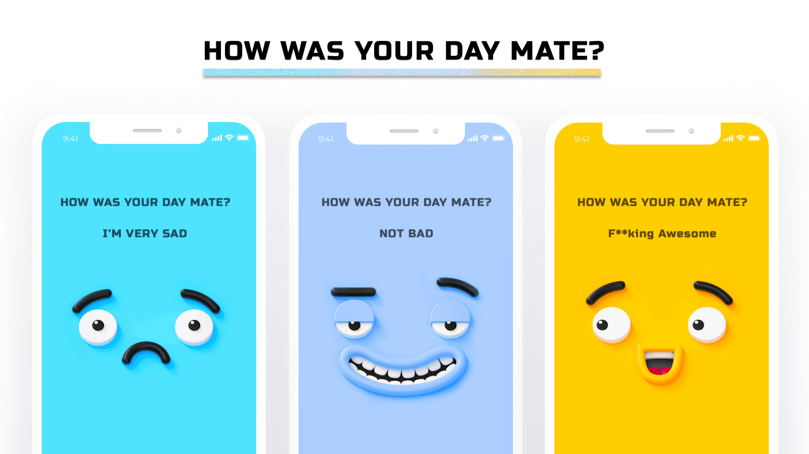
A platform for analyzing mental health issues and suggesting possible solutions using AI based chatbot

Slide 4
Objective
People are facing many mental health issues nowadays especially in the current times of crisis such as loneliness, depression, anxiety, etc.
Our prime objective is to help people deal with these cases in a positive way and reduce self harm
People can talk about their issues openly and frankly without any inhibitions or hesitations
To help people introspect and be a better version of themselves

Slide 5
Key Features
Chatbot along with human voice tone recognition
Try to bring about a positive outlook in people by talking to them using CBT treatment
Suggest them solutions like meditation, writing journals, watching YouTube videos, reading inspirational books, etc.
If they are not able to get out of this situation through self care then we can give them the contact of the psychiatrist or any social worker who is willing to help that person
According to the ratings out of 10, we would give an alert message to that person’s family and friends so that they won’t leave them alone

Slide 6
Thank You..!!

